Slide 1
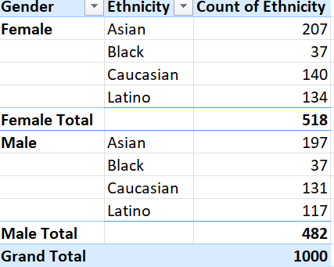
Question1:
Answer: The ethnicity distribution for each gender in the company is shown in the picture.
Steps:
Make a pivot table of the data.
Get the gender and the ethnicity in the row and count of ethinicty in the values.
Select the pivot table, from Design make it tabular format .

Slide 3
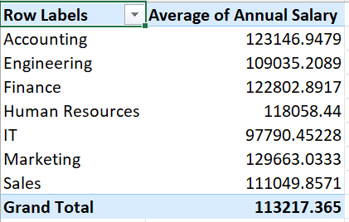
Question 3
Answer: Yes there is significant difference between average of salaries of different departments.
Steps:
1.Get a pivot table of the data
Get the departments in the row and the salaries I the column.
From value field settings change to average.
The outcoming table is this one.

Slide 4

QUESTION 4
CREATE A PIVOT TABLE
SELECT THE COUNTRY IN COLUMNS
AND COUNT OF EEID IN VALUES
GET THE TOP 1 USING FILTERING
Answer United states

Slide 5
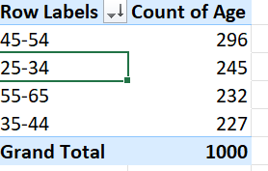
Question 5
Answer: 45-54 (considering the range of 10)
Steps:
1.Make a pivot table of the data.
2. Put the age column in row and values
3. In the values from field setting change it to count.
4. In the table, group the age from the group option after right clicking . Set the age gap to 10.
45-54 shows the most number of people.

Slide 6
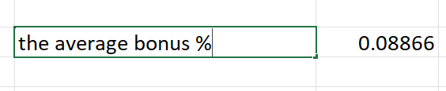
Question 6:
Answer the average bonus % 0.0.8866
Steps:
click in a cell, put =average(select all the bonus % values)

Slide 7
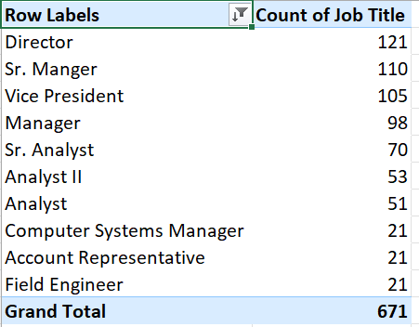
Question 7:
Answer : the “Director” job title occurs the most number of times. However the top 10 most frequent job titles is as follows.
Steps:
1.Make a pivot table of the data.
2. Put the job title in both rows and values
3. Get the top 10 job titles.
4. Sort according to the count of job titles.

Slide 8
Question 8:
No primary reasons given for employee exists.

Slide 9
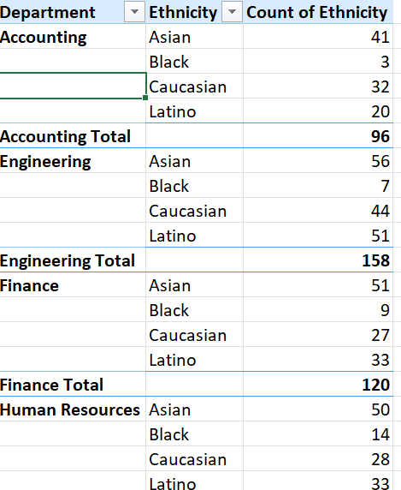
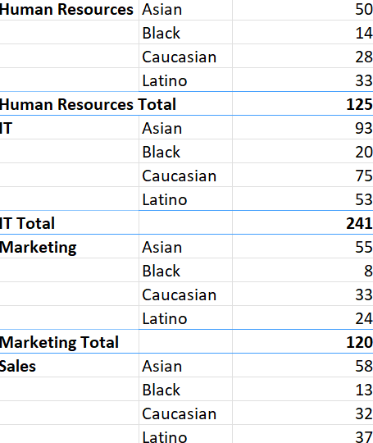
Question 9:
Answer: Yes, some department are more diverse than others.
In Accounting the no. of Caucasian is just 3 while other ethinicty is more than 20.
In Marketing black is just 8, finance no. of black ethinity is 9. engineering it is 7.
While departments like human resourses is more diverse than the rest of the departments.
Steps:
make a pivot table
Put department and ethinicty in the rows and ethnicity count on the values.

Slide 10
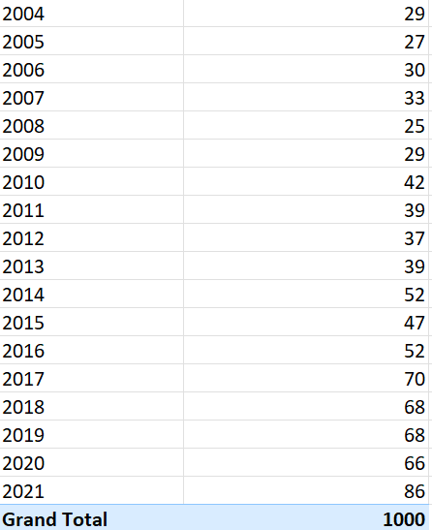
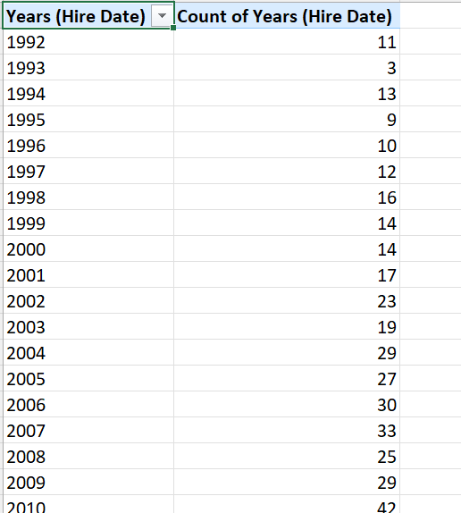
QUESTION 10: YES THERE HAS BEEN AN INCREASE IN THE NUMBER OF HIRING.
Steps:
Create a hire date column in the data sheet.
Cretae a pivot table
Count the frequency of hiring for each year.

